Slide 1

Grouping Anagrams Using Strings and Sorting
Presented by : P Suryatej Kaasyap (25261A04H6)
Y Lohith (25261A04K1)
Academic Year : 2025-26
Project Guide : Dr. Y. Praveen Kumar Reddy
Date :15-05-26

Slide 2


Abstract
Anagrams are words formed by rearranging the letters of another word while preserving all original characters exactly once. Identifying and grouping anagrams is a common problem in string processing and algorithm design.
This project focuses on designing and implementing an efficient program to group a collection of words into corresponding anagram sets. The implementation is carried out using the C programming language with concepts such as arrays, strings, sorting techniques, and comparison operations.
The core idea behind the solution is to convert every word into a canonical form by sorting its characters alphabetically. Words sharing the same sorted representation are grouped together as anagrams.
The project demonstrates efficient data organization and string manipulation techniques while providing practical exposure to algorithmic problem solving.
1

Slide 3
Introduction
String processing plays an important role in computer science applications such as text analysis, search optimization, spell checking, and natural language processing. One interesting string manipulation problem is the identification of anagrams.
An anagram is formed when the letters of a word are rearranged to produce another valid word while maintaining the same character frequency. For example, the words listen and silent are anagrams.
2

Slide 4
Anagram Algorithm
1. Start
2. Input the number of words `n`.
3. Read all words into the array words[ ][ ].
4. For each word:
Copy the word into another array sorted[ ][ ].
Sort the characters of the copied word alphabetically using sortString().
5. Initialize a visited[ ] array with all values as 0.
Algorithm :
3

Slide 5
6. For each word i from 0 to n-1:
If visited[i] is 1, skip it.
Print the current word.
Mark visited[i] = 1.
7. Compare the sorted form of the current word with all remaining words:
If sorted[i] equals sorted[j] using strcmp( ):
Print the word.
Mark visited[j] = 1.
8. Print a new line after each anagram group.
9. Stop.
4

Slide 6

Time Complexity
For grouping and processing words, time required:
$$O\left(n⋅k\log{k}\right)$$
where:
✓ n = number of words
✓ k = maximum word length
Time Usage Breakdown:
✓ Sorting each word → $O\left(k\log{k}\right)$
✓ Sorting all words → $O\left(n⋅k\log{k}\right)$
✓Comparing sorted words (grouping) → $O\left(n^{2}⋅k\right)$
5

Slide 7
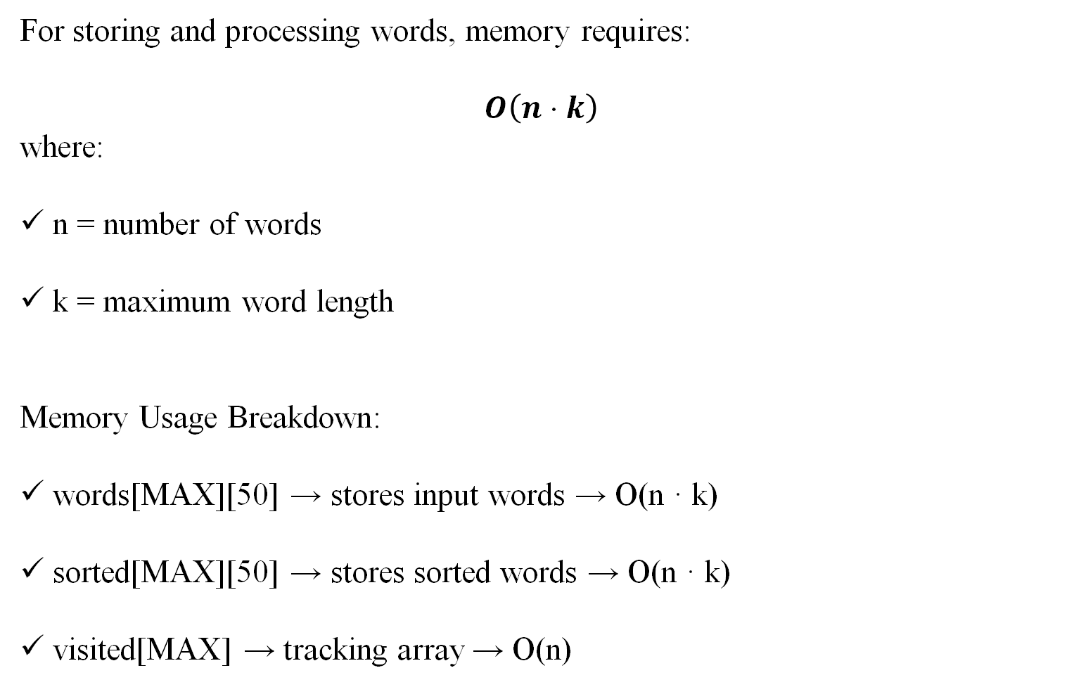
Space complexity
For storing and processing words, memory requires:
$$O\left(n⋅k\right)$$
where:
n = number of words
k = maximum word length
Memory Usage Breakdown:
words[MAX][50] → stores input words → O(n · k)
sorted[MAX][50] → stores sorted words → O(n · k)
visited[MAX] → tracking array → O(n)
6

Slide 8
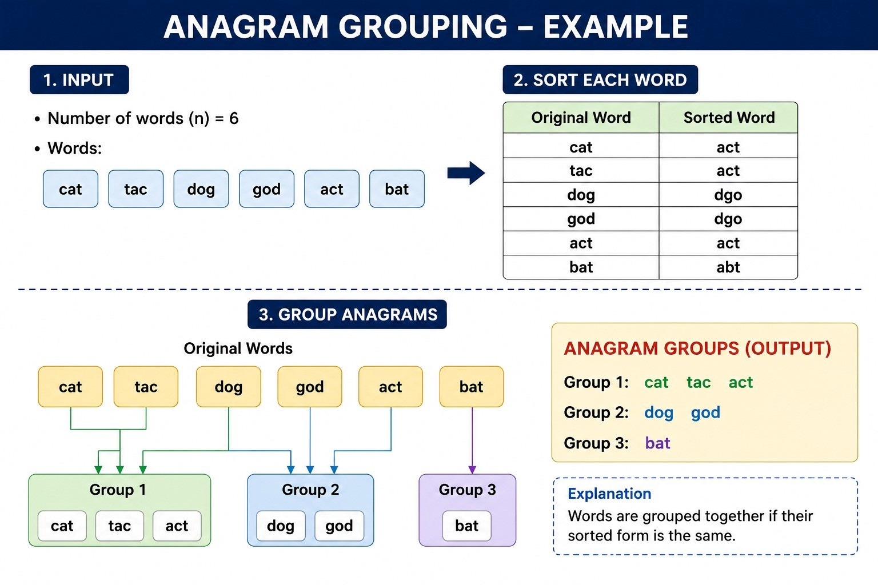
Example
7

Slide 9
Technical Applications
1. Compiler Design
Used in lexical analysis and pattern matching of strings.
2. Database Management Systems (DBMS)
Helps in grouping similar text records and removing duplicate patterns.
3. Search Engines
Improves search suggestions by detecting rearranged keywords.
Example:
"silent" ↔ "listen“
8

Slide 10
4. Cybersecurity & Cryptography
Used in basic encryption/decryption techniques involving character rearrangement.
5. Natural Language Processing (NLP)
Useful in text mining, word similarity checking, and language processing systems.
6. Artificial Intelligence
Used in intelligent word prediction and language-based AI systems.
9

Slide 11
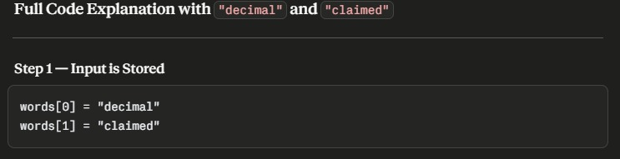
​
10

Slide 12
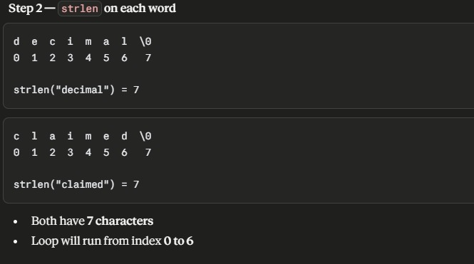
​
11

Slide 13
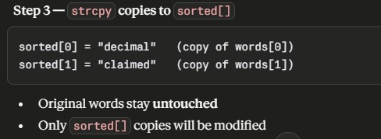
​
12

Slide 14
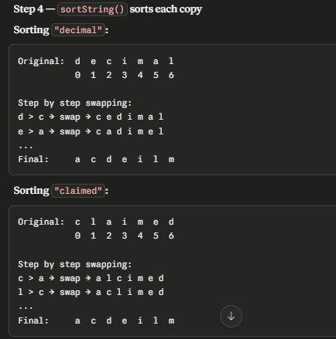
​
13

Slide 15
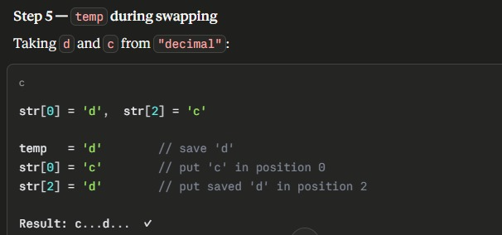
​
14

Slide 16
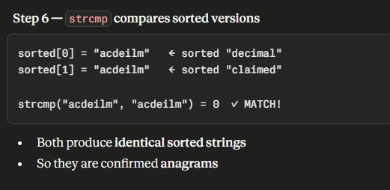
15

Slide 17
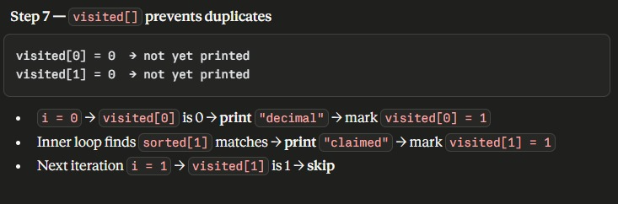
16

Slide 18
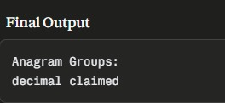
17

Slide 19
References
AI-based tools such as ChatGPT and Gemini used for conceptual understanding, report structuring, and code development support and images.
Yashavant P. Kanetkar, Let Us C, BPB Publications.
Aho, A. V., Sethi, R., and Ullman, J. D., Compilers: Principles, Techniques, and Tools, Addison-Wesle
18

Slide 20
Thank You

